Slide 1
KS3 Electricity – Lesson 7
Magnets

Slide 2
Learning Objective
To investigate magnets.
Success Criteria
To identify materials that are attracted to magnets.
To construct a compass.
To apply my knowledge of magnets to plot magnetic field lines.

Slide 3

Starter: True or False?
1
All metals are magnetic.
false
2
true
All magnets have a north and south pole.
3
The earth has its own magnetic field.
true
4
Like poles attract.
false
5
true
Opposite poles attract.
6
true
The earth has a magnetic core.
Extension Question: What else do you know about magnets?

Slide 4

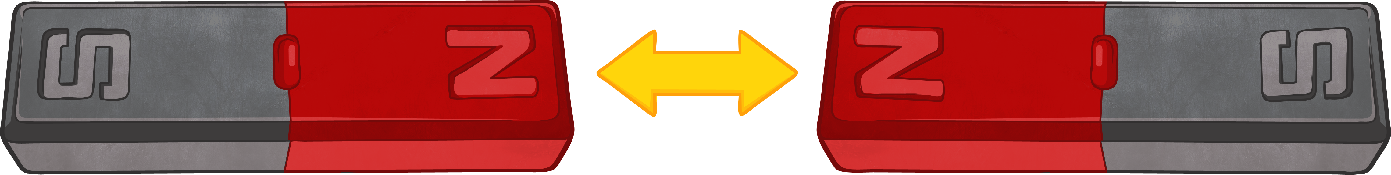
Magnetism
Magnetism is an invisible force.
All magnets have a north and a south pole.
Like poles repel. This means that the two poles will push away from each other.
Opposite poles attract. This means that the invisible magnetic force between the magnets will force the poles together.
Not all metals are magnetic. Iron, nickel and cobalt are the three magnetic metals.
The earth has a magnetic inner core made of iron.

Slide 5

Investigation
You are now going to carry out a short investigation to find out which materials are magnetic and which are not.
In your groups, you will need the following: aluminium can, iron nail, paperclip, tweezers, pencil, tennis ball, screw and a magnet.
Place the magnet on each object. If the magnet is attracted towards the object, we say that it is magnetic.
Object | Prediction – Magnetic Yes or No? | Result
aluminium can
iron nail
paperclip
tweezers
pencil
tennis ball
screw
ruler

Slide 6
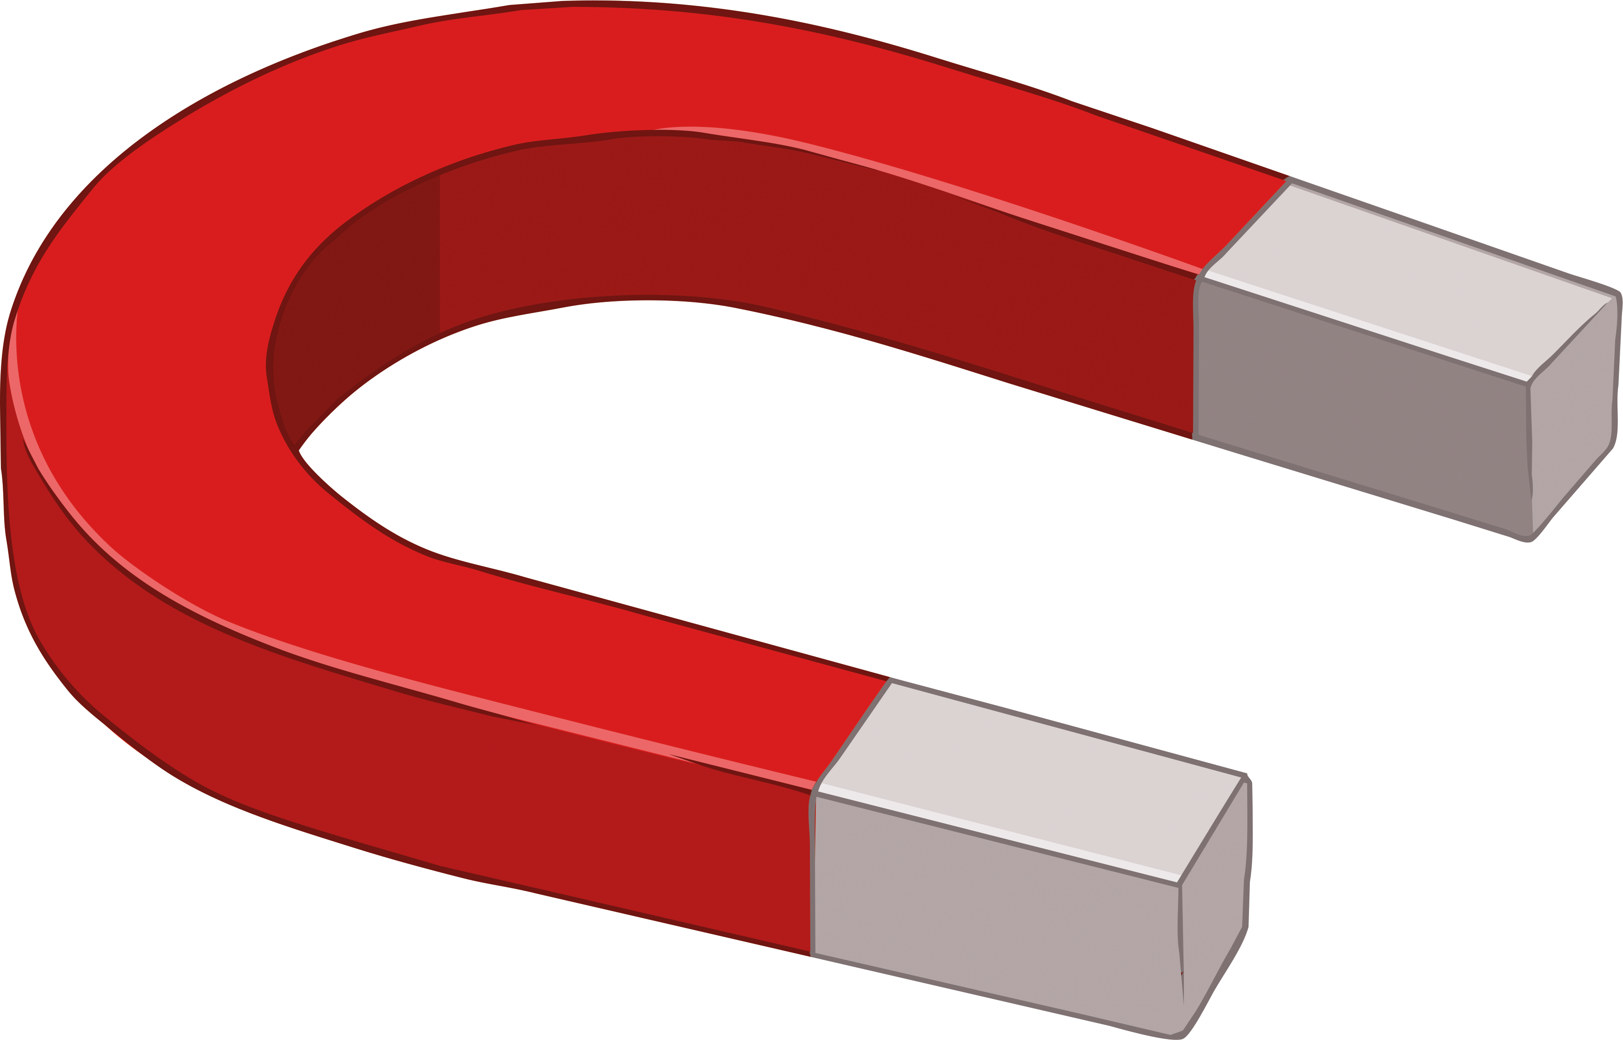
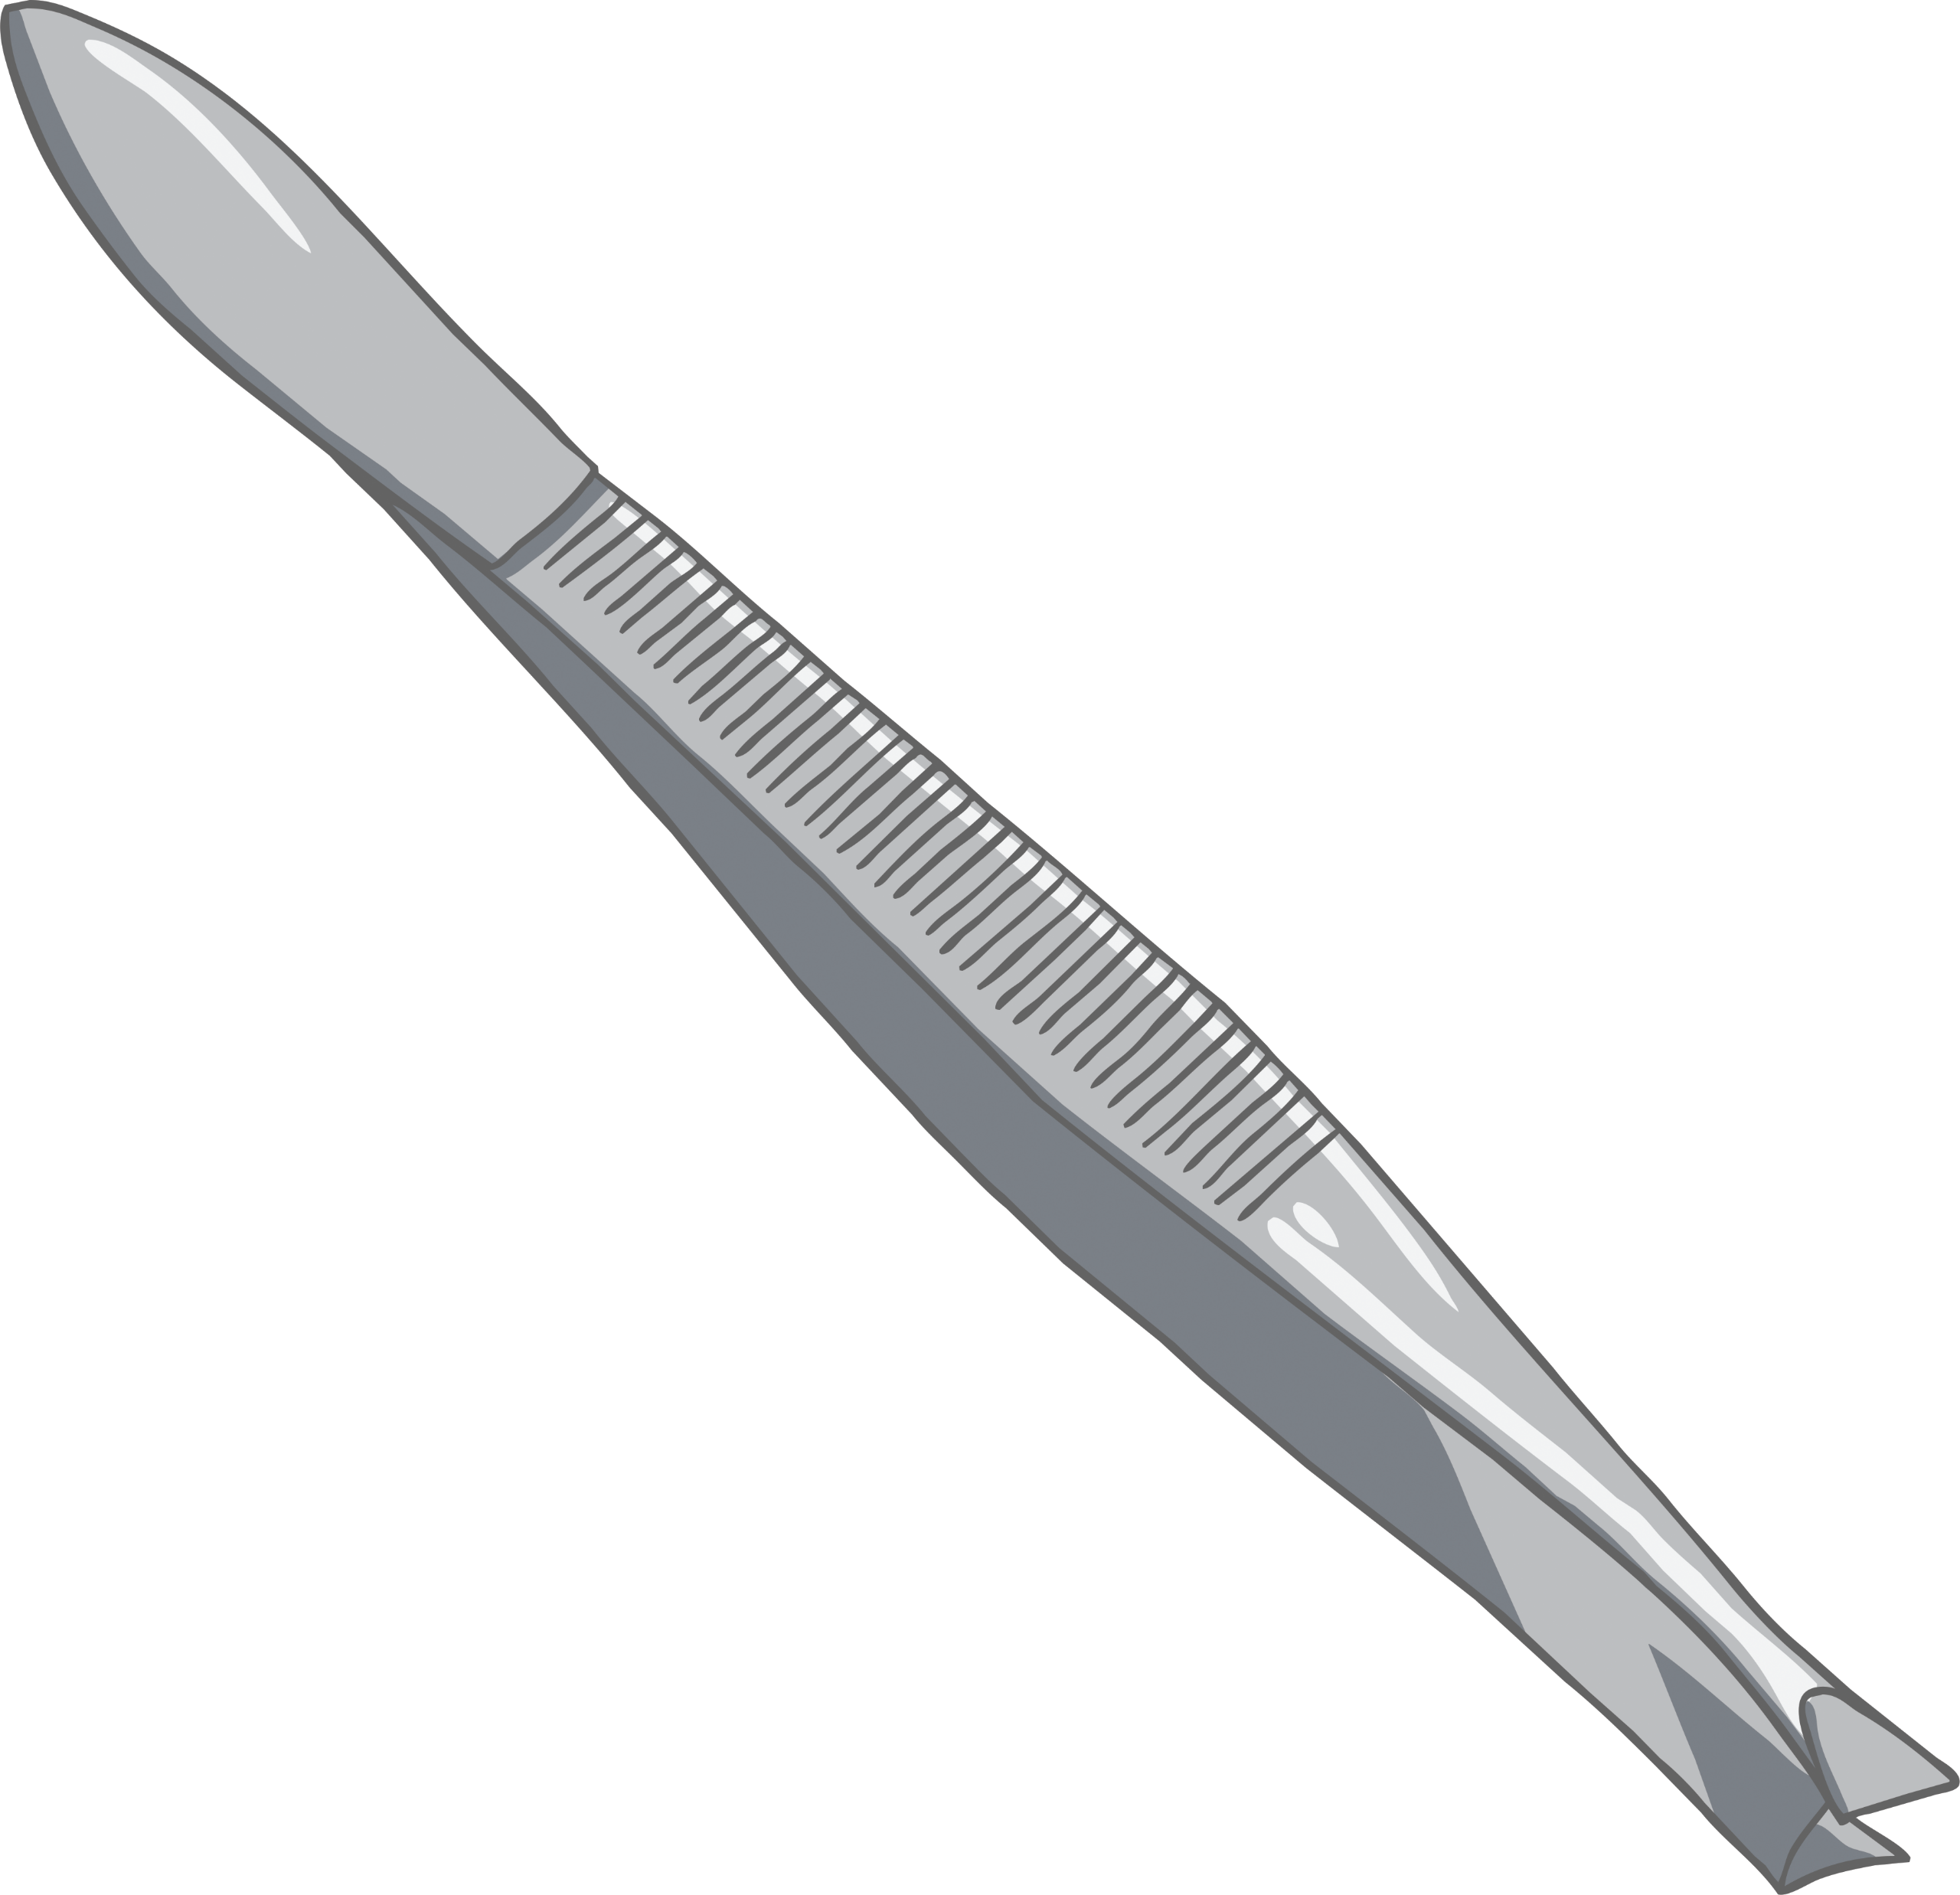
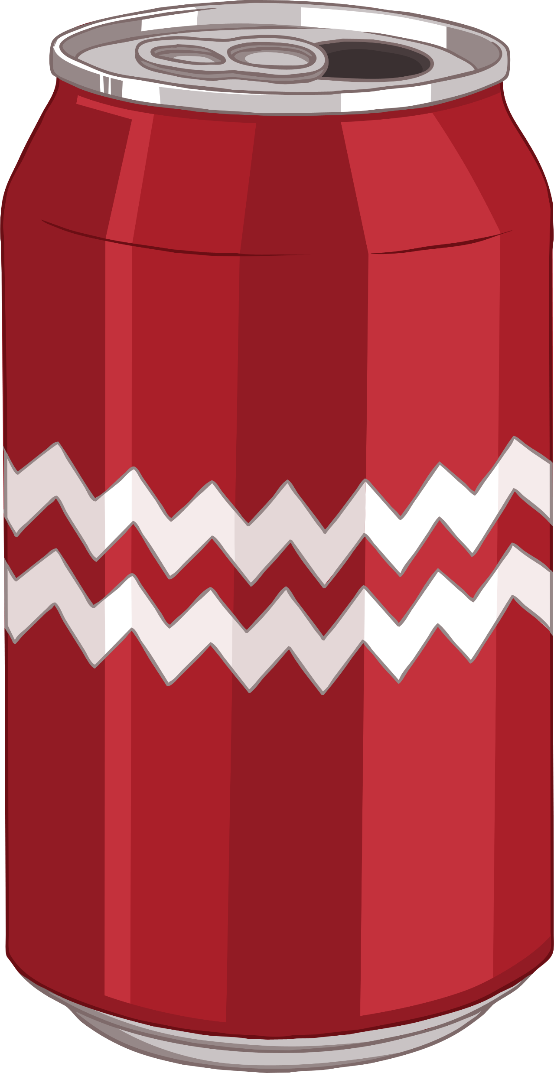
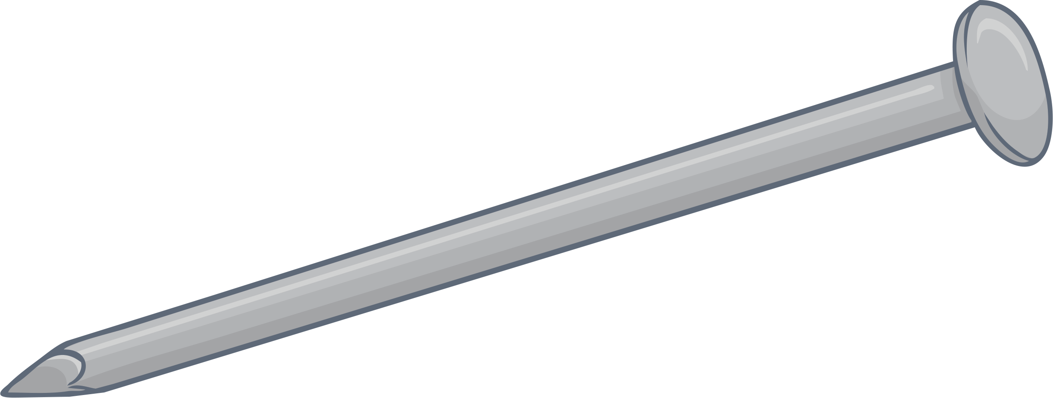
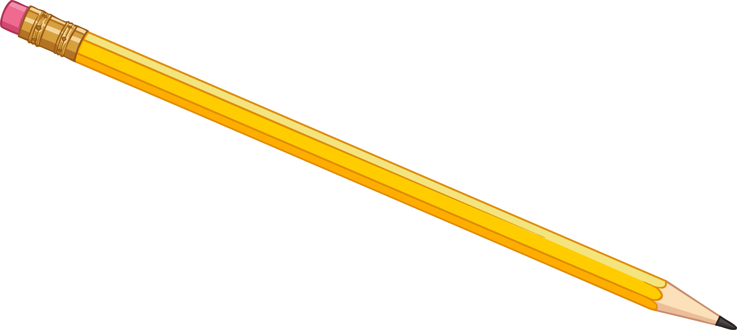
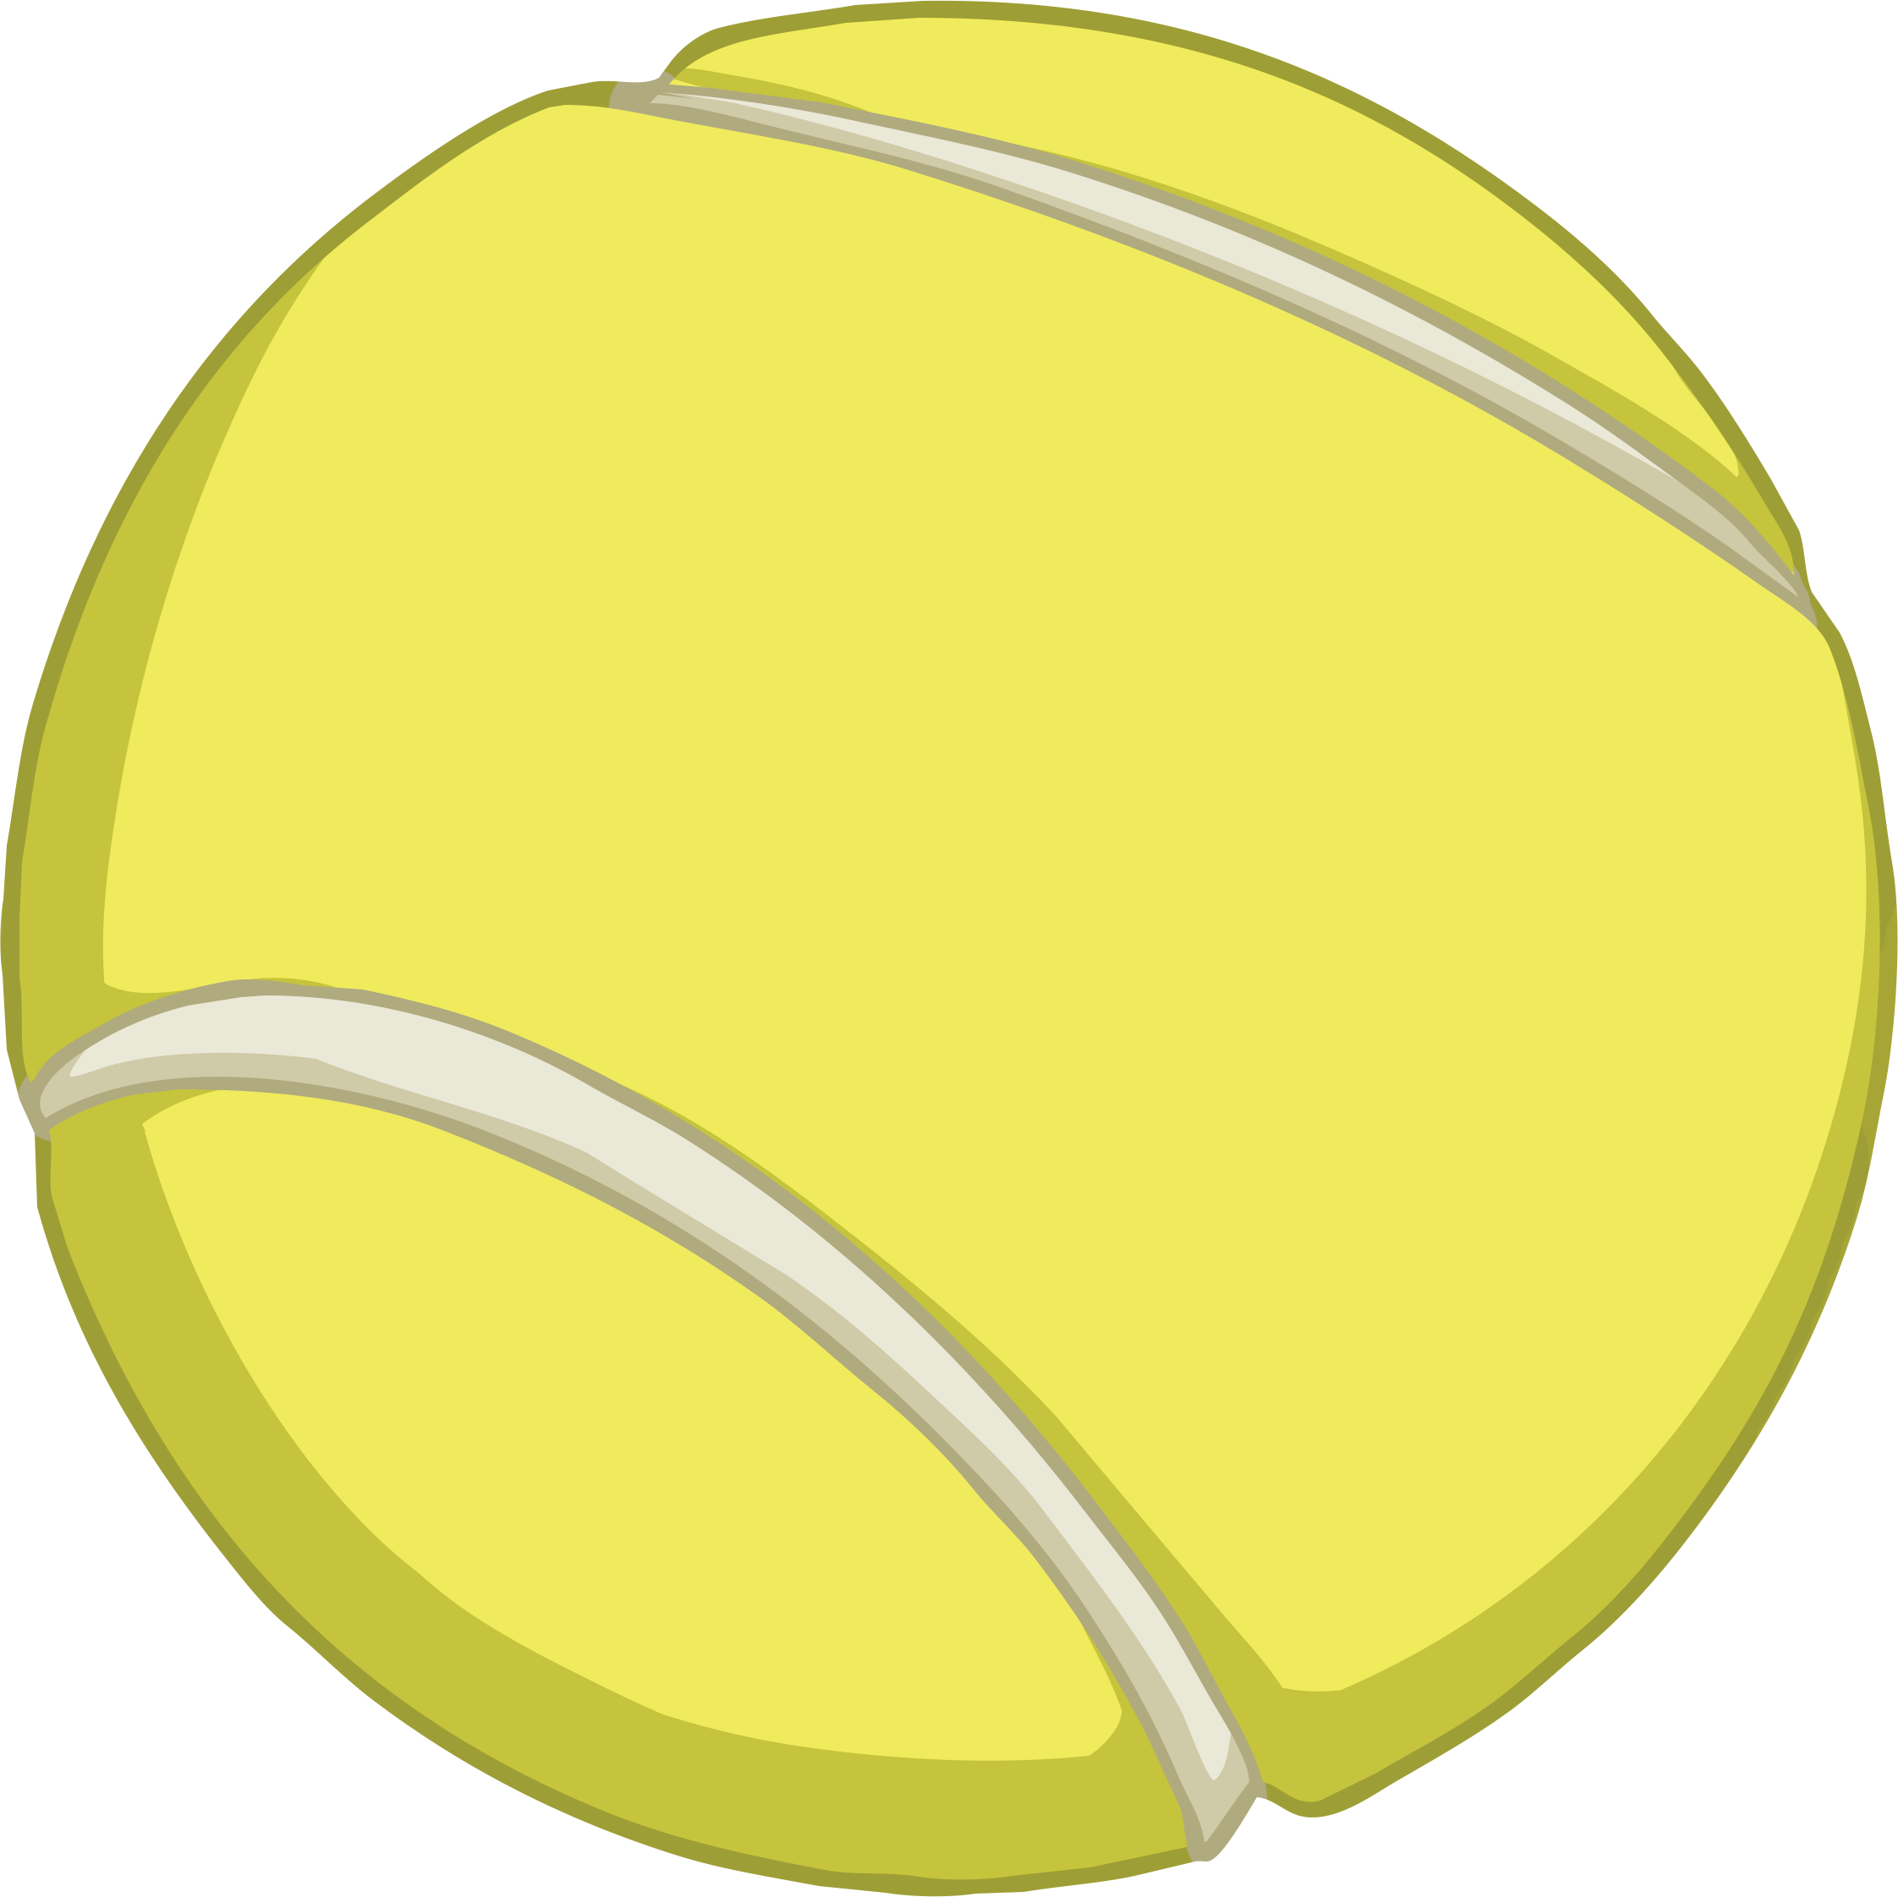
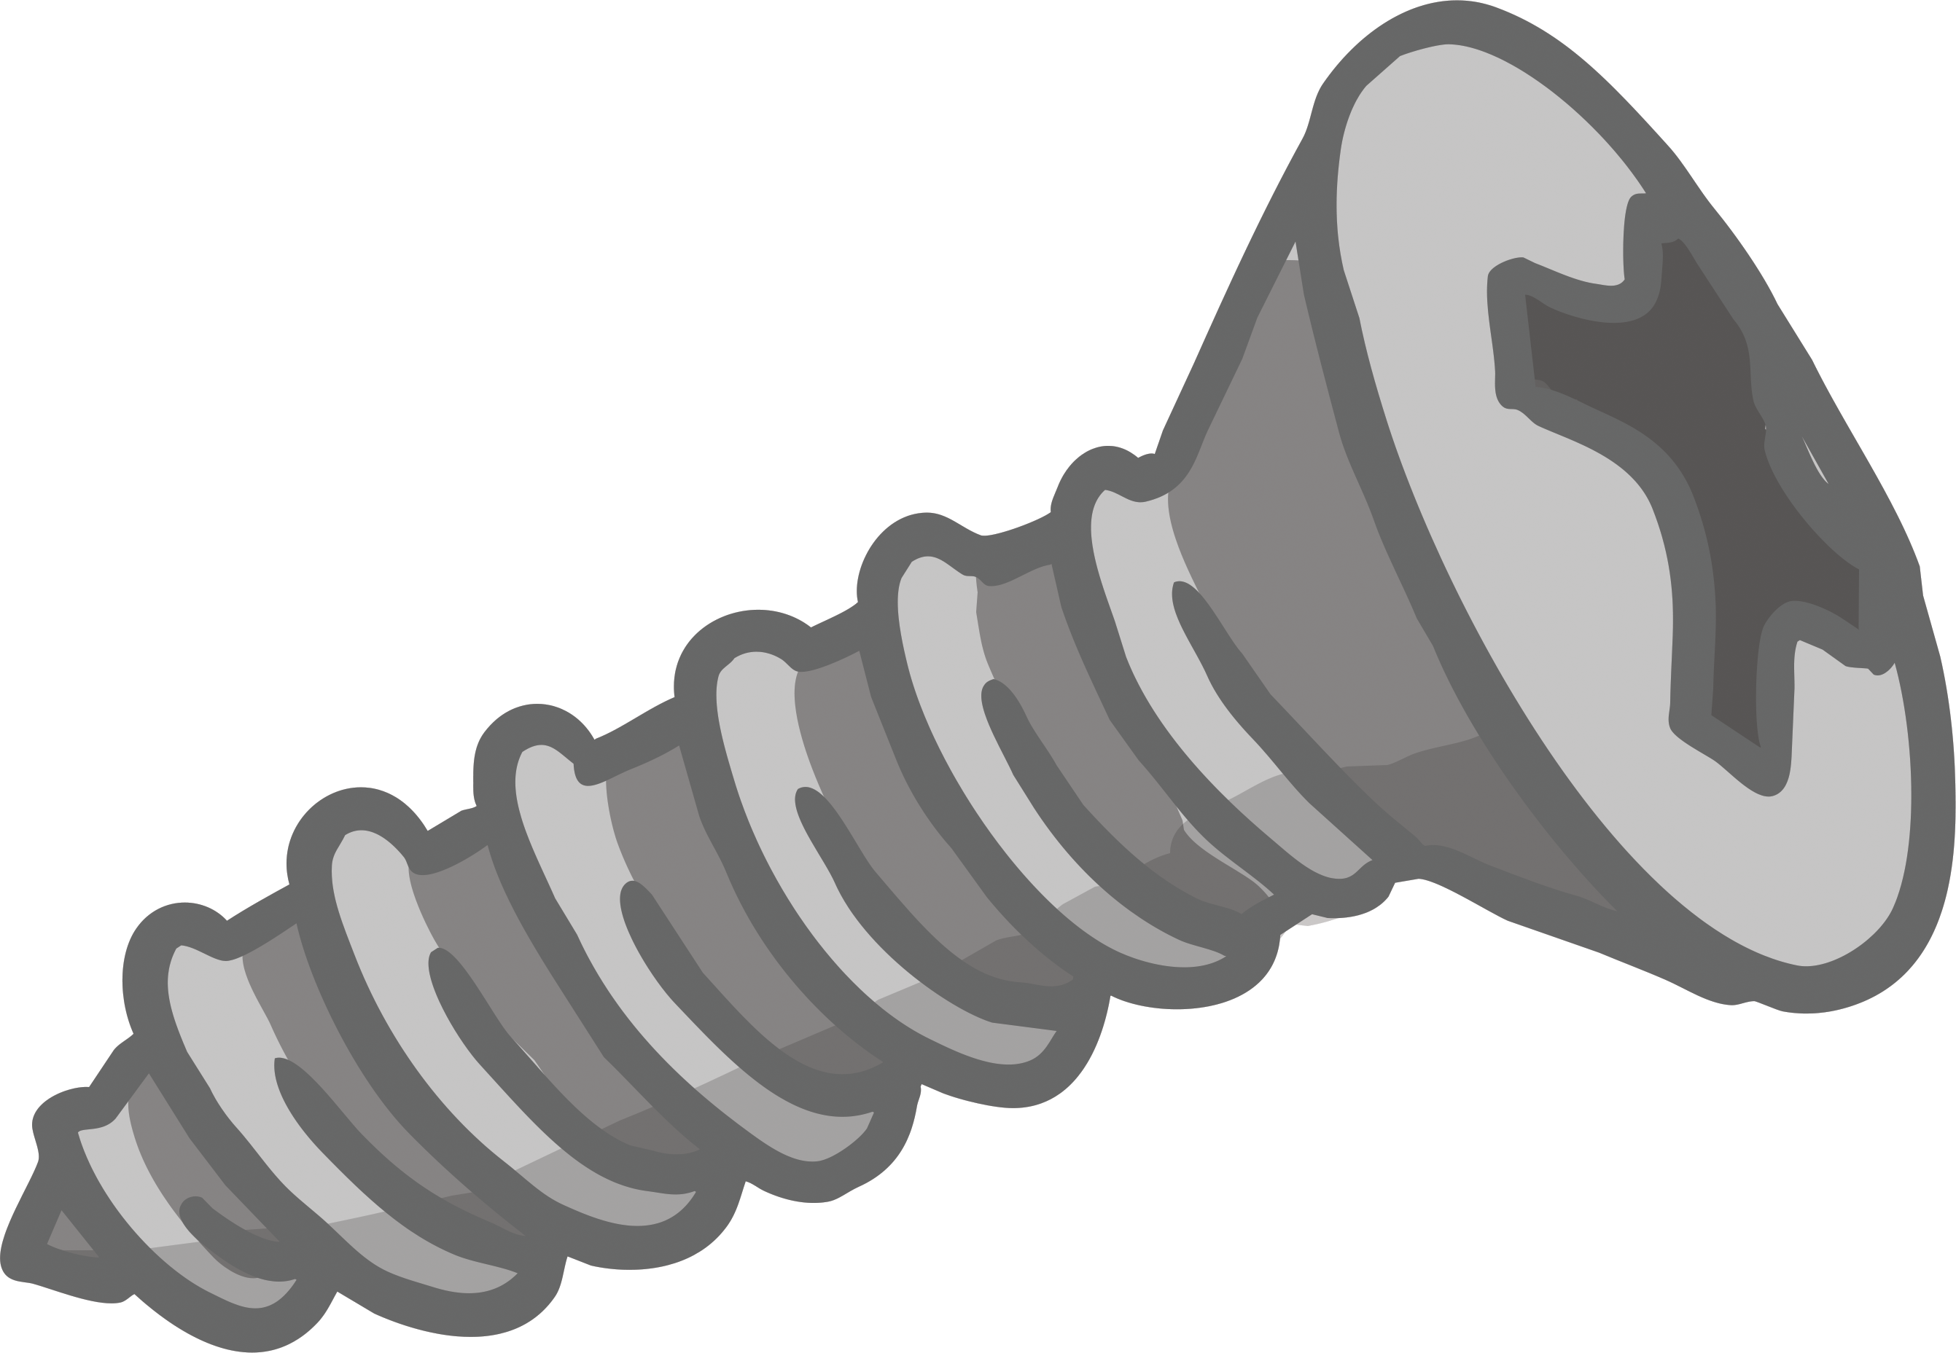
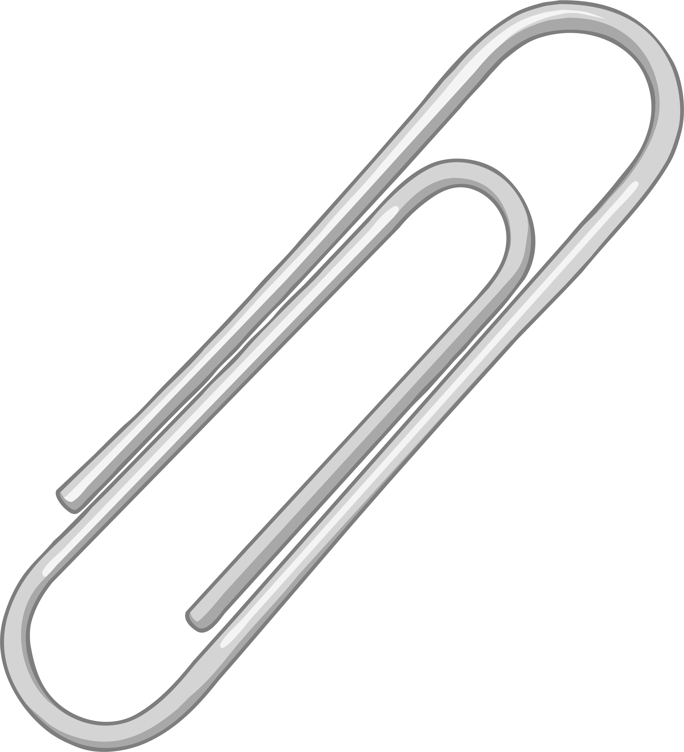
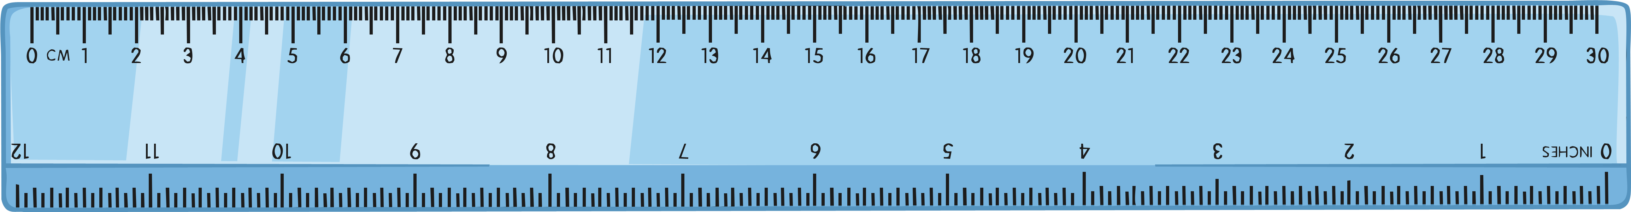
Investigation Answers
What did you find out from the investigation? Which materials were magnetic and which were not?
non-magnetic
magnetic
non-magnetic

Slide 7
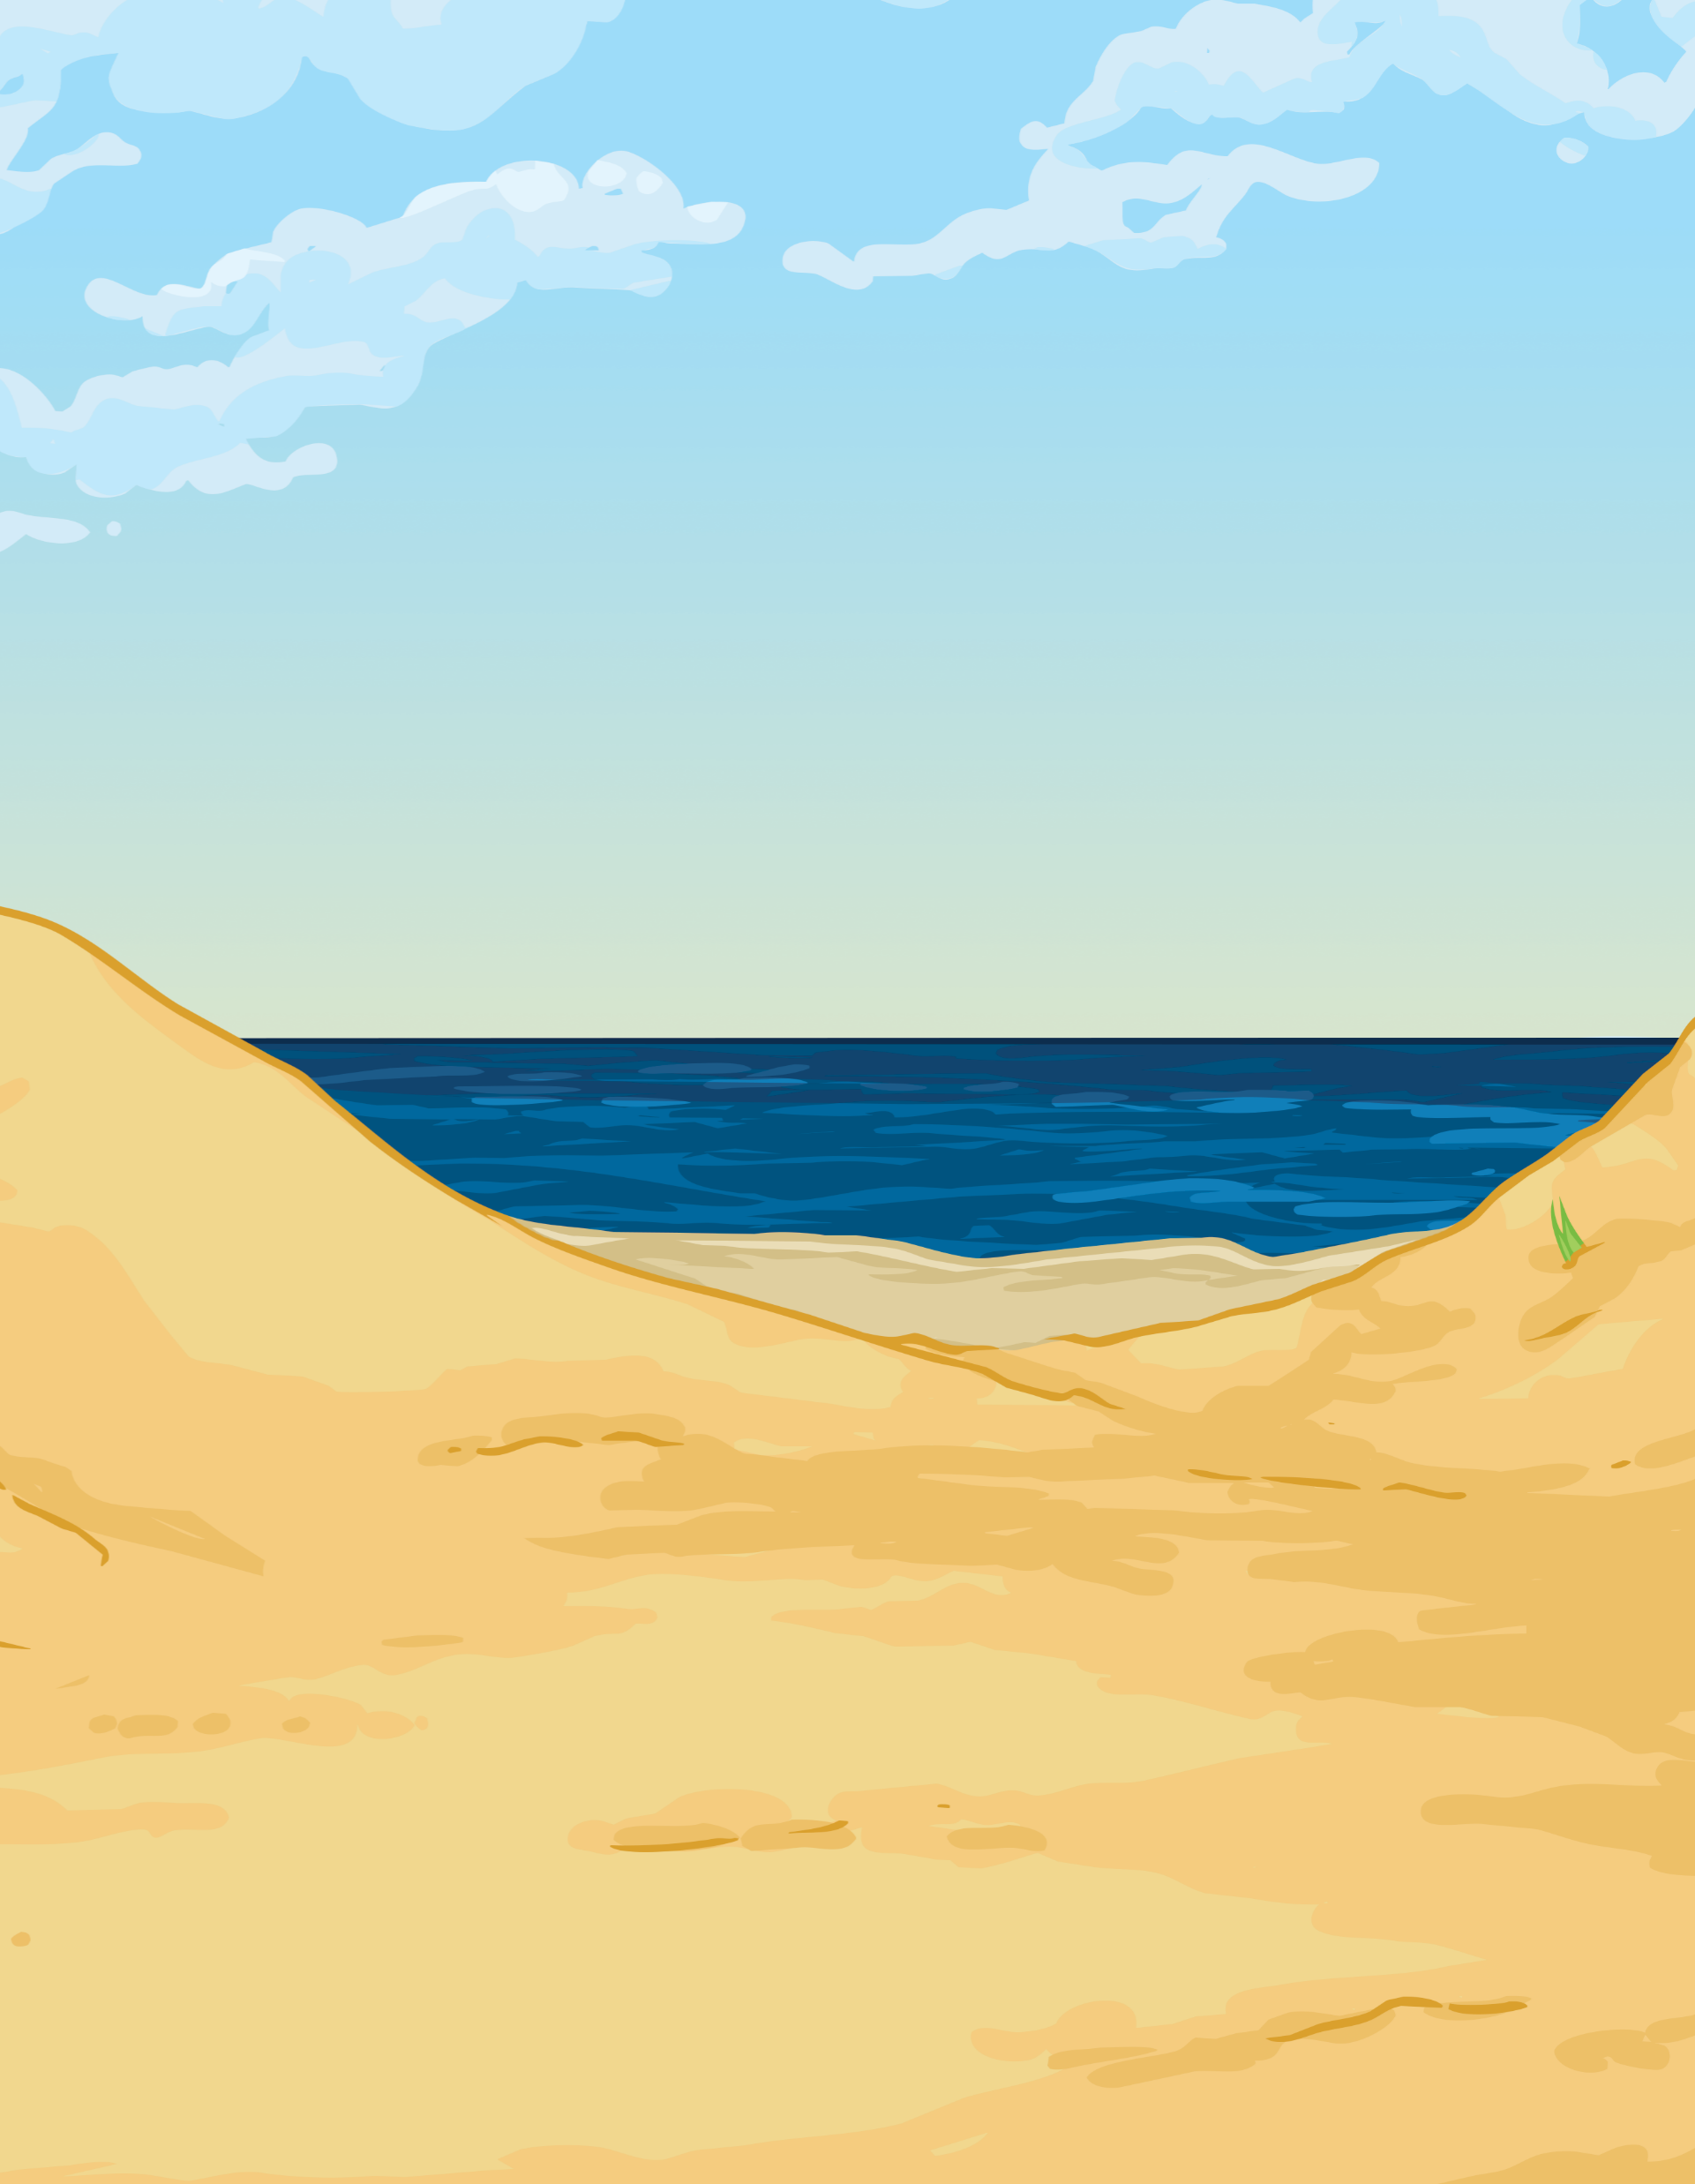
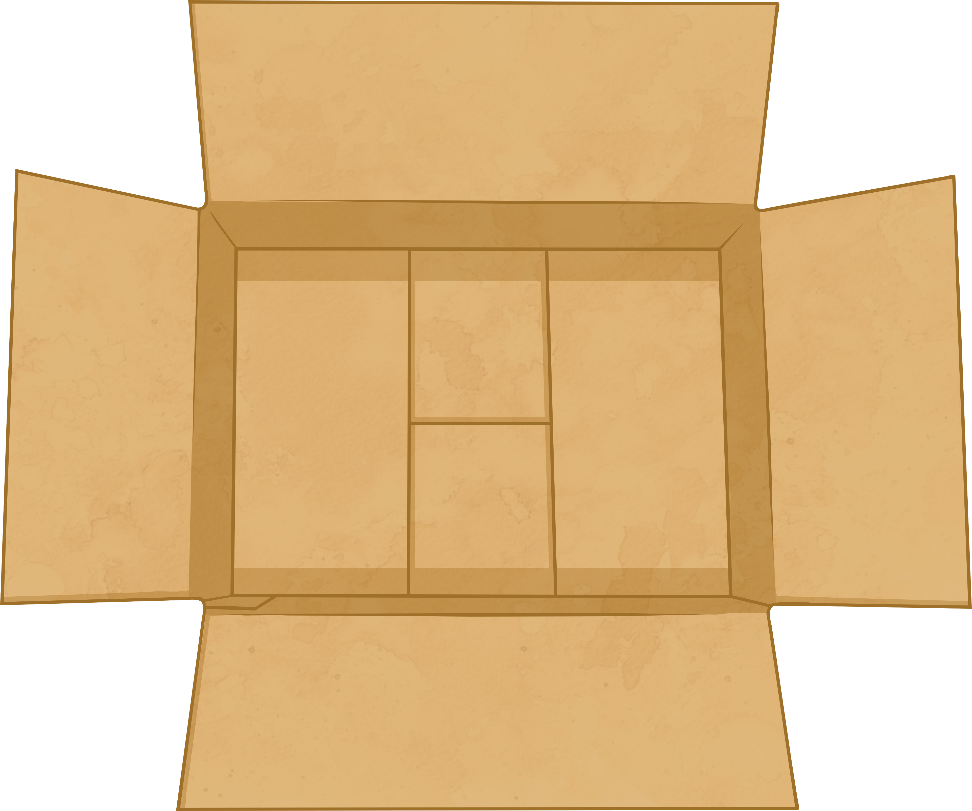
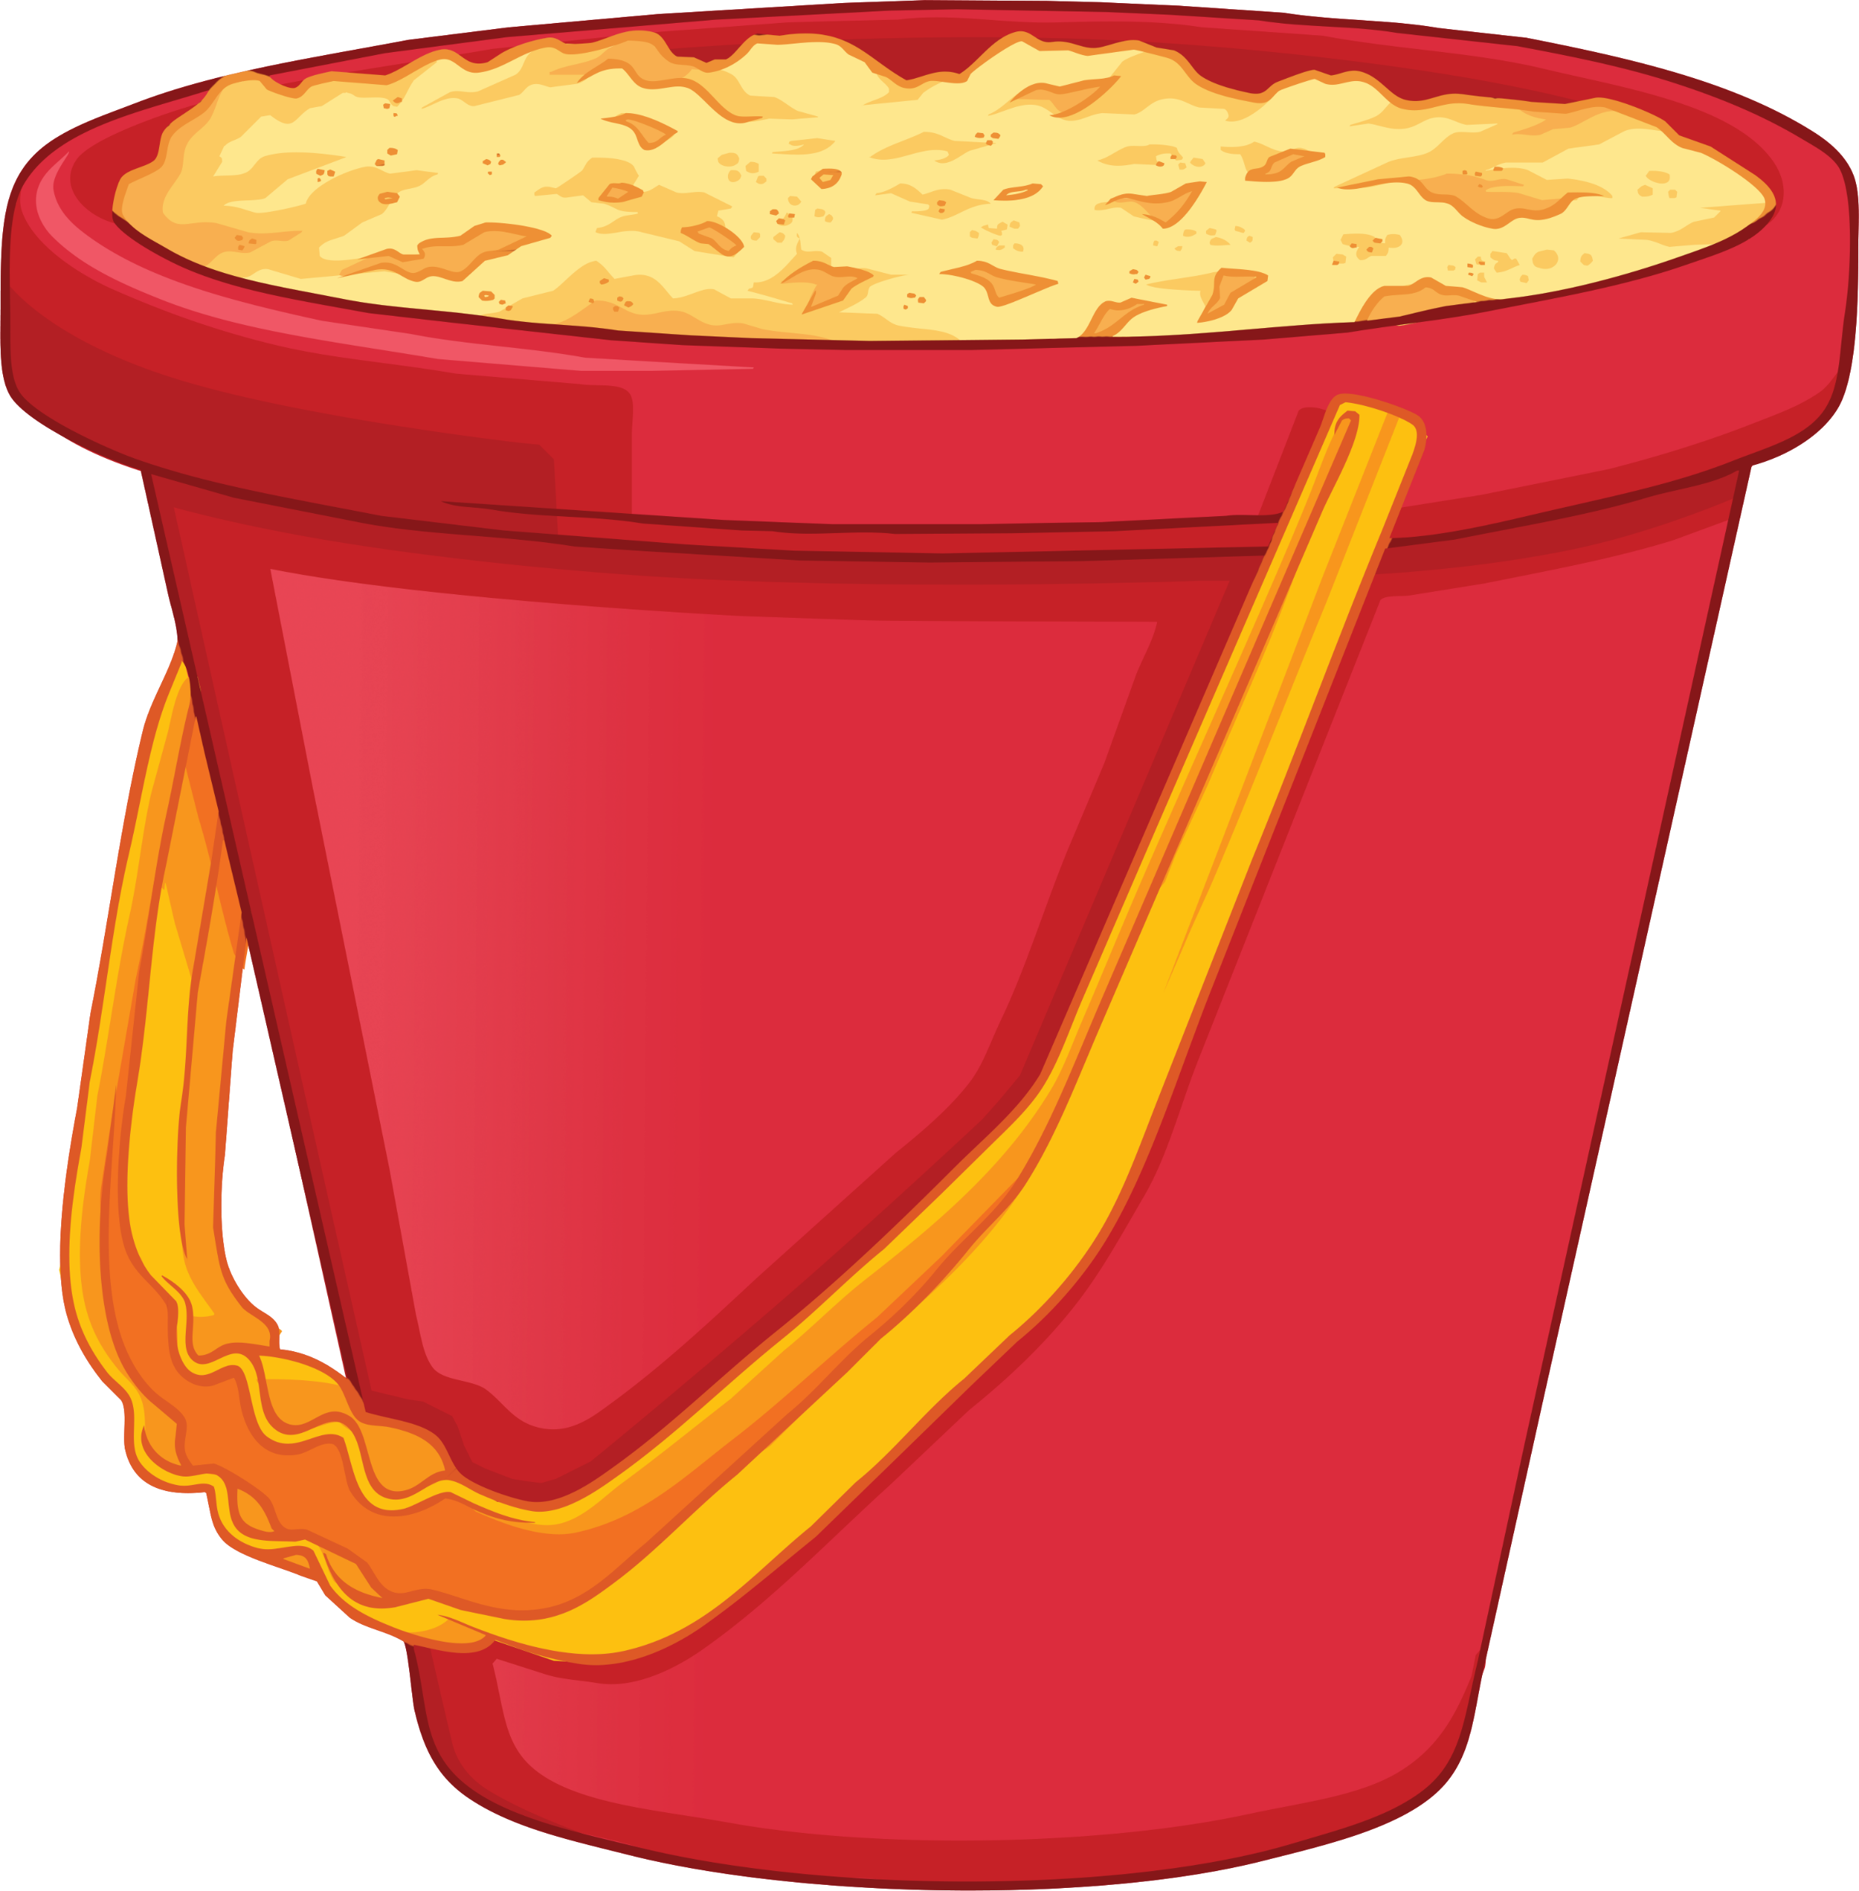
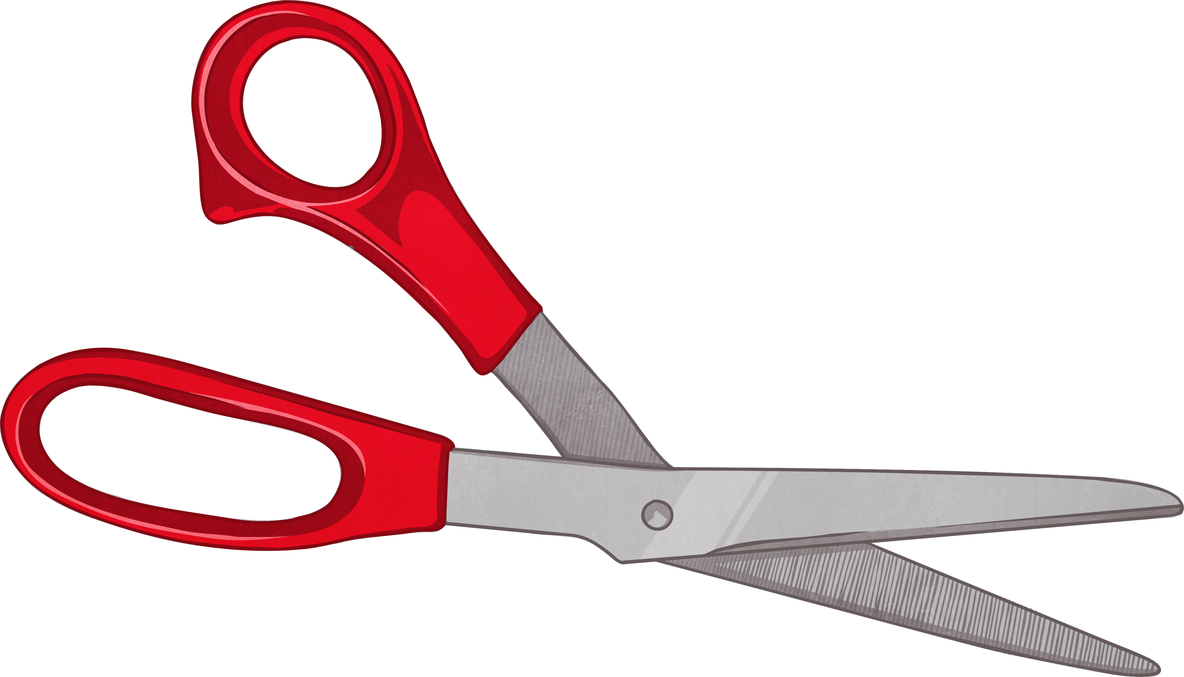

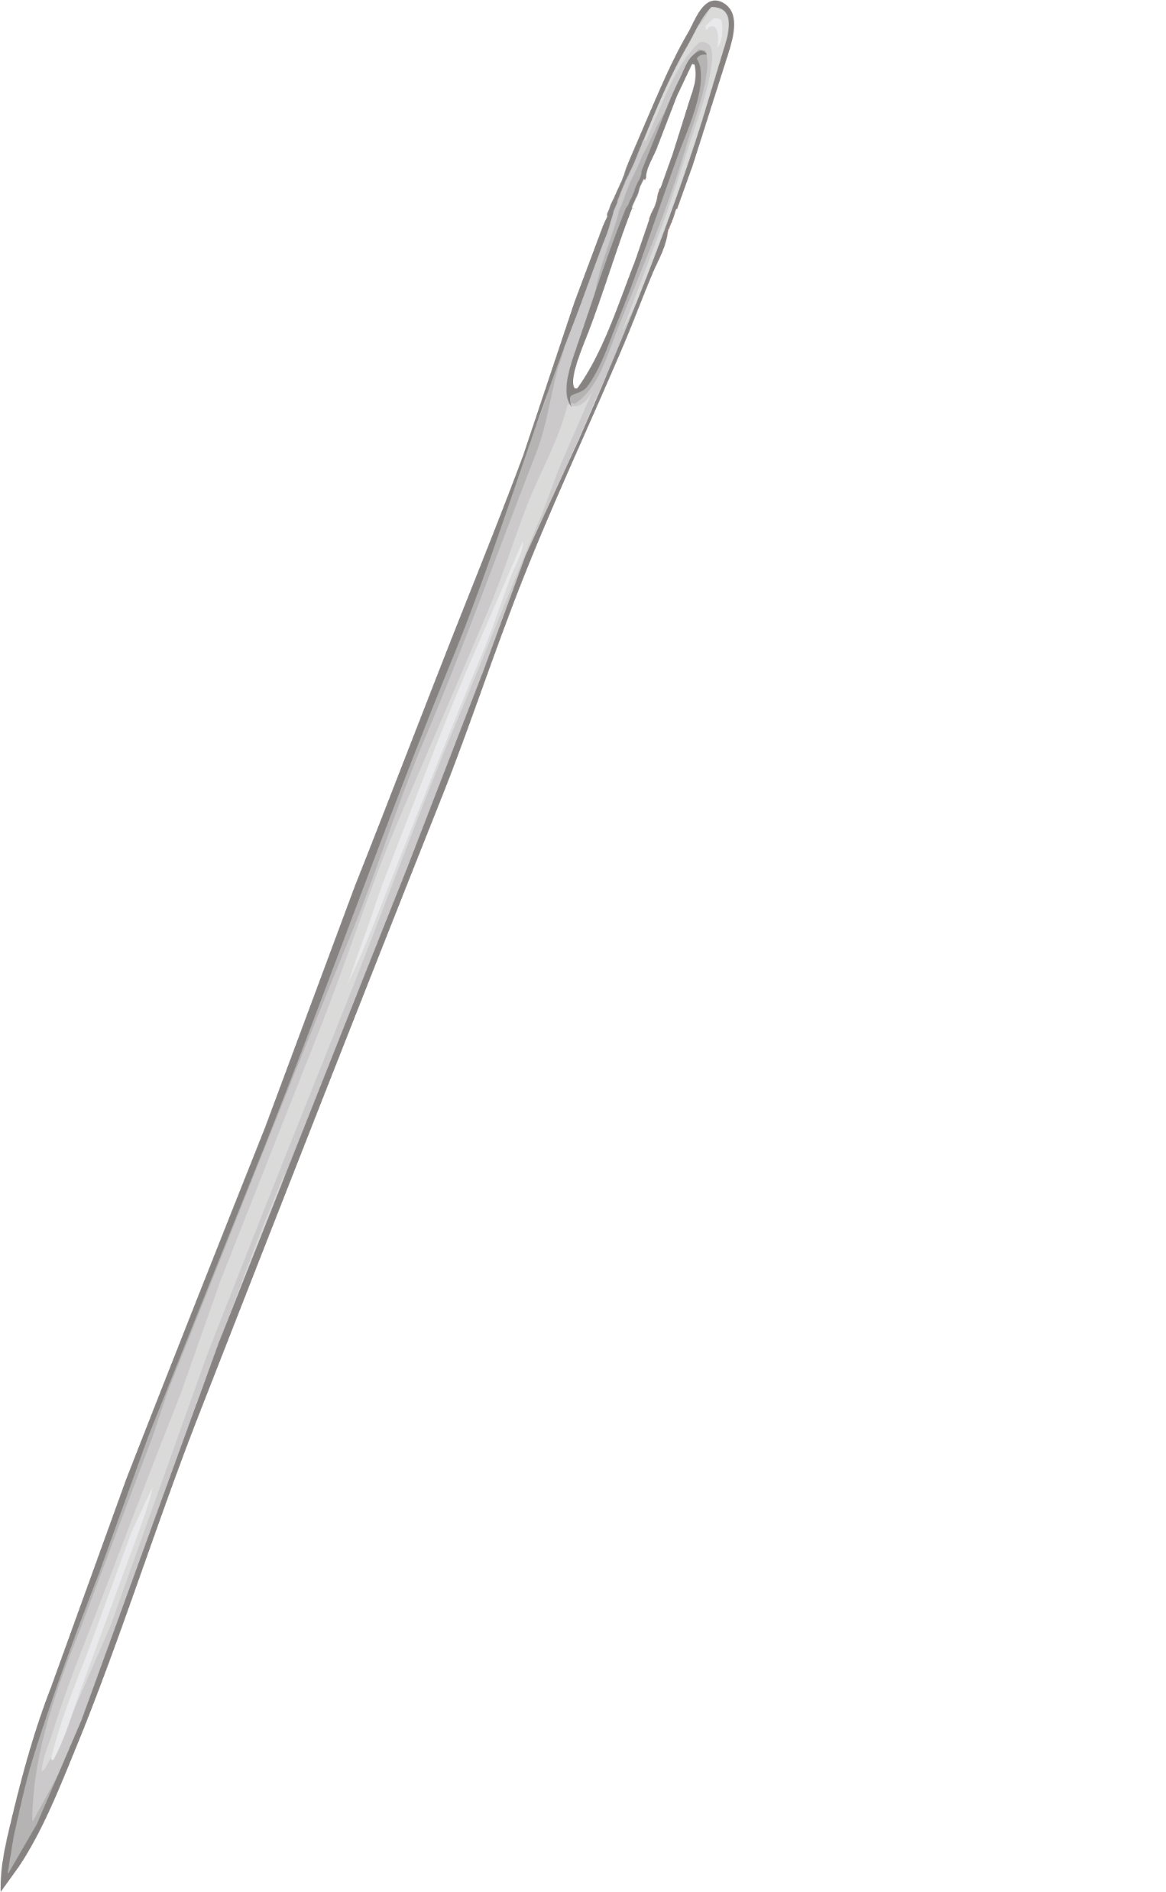
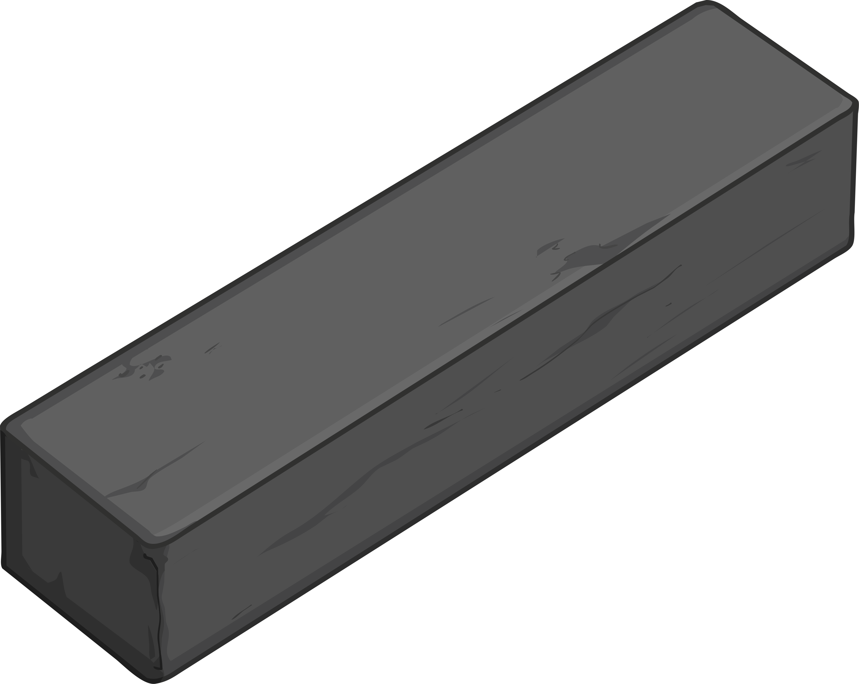
Desert Island
You are taking part in an around the world sailing competition. Unfortunately, a storm has blown you off course and your boat has crashed into the rocks off the coast of a tiny island in the South Pacific.
Your lucky compass was damaged in the accident; all the other competitors are heading north and you now have no way of getting back into the race.
Your racing boat needs to be fixed. While fixing the side of the boat, you notice a box that has washed up onto the shore. Within the box you find a sewing needle, bar magnet, wax paper, scissors, bucket and water.
You have two minutes to discuss with a partner how you could use the equipment below to make a compass.

Slide 8
Making a Compass
In your groups, you will need to collect the following pieces of equipment:
1 bar magnet, wax paper, scissors, 1 sewing needle, bucket, water.
Step 1 – Collect the equipment.
Step 2 – Hold one end of the needle and stroke the magnet over the needle several
times – this will magnetise the needle.
Step 3 – Switch ends of the needle and use the opposite side of the magnet to stroke
the needle several times to magnetise the needle.
Step 4 – Cut a circle out of the wax paper. The circle should have a diameter of
one inch.
Step 5 – Thread the needle through the diameter of the wax paper circle. You have
now made your compass.
Step 6 – Fill the bucket with water.
Step 7 – Carefully place your compass on the top of the water. Once the compass
stops spinning it should point north. Now proceed northwards and catch up
with the other competitors.

Slide 9
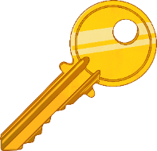

Knowledge Check: Gold
In your own words, explain everything you know about magnets. Use the keywords in the box to help you frame your answer.
Keywords
repel
cobalt
attracted
away
north
south
magnetic force
opposite
poles
metal

Slide 10
Knowledge Check: Silver
In your own words, describe/explain everything you know about magnets. Use the keywords and sentence starters to help you frame your answer.
Magnets have two poles…
Not all metals are magnetic, only three are able to …
Magnets are attracted to…
Keywords
repel
cobalt
attracted
away
north
south
magnetic force
opposite

Slide 11
Knowledge Check: Bronze
Check your knowledge of magnets. Use the keywords to help you fill in the blanks.
Magnets have two poles…
Magnets have two poles. One end of a magnet is called the pole and the other end of a magnet is called the pole.
poles attract. This means that the invisible between the magnets will force the poles together.
Like poles . This means that the two poles will push from each other.
Magnets are to objects that are made out of metals that are magnetic such as iron, nickel
and .
Keywords
repel
cobalt
attracted
away
north
south
magnetic force
opposite
north
south
Opposite
magnetic force
repel
away
attracted
cobalt

Slide 12
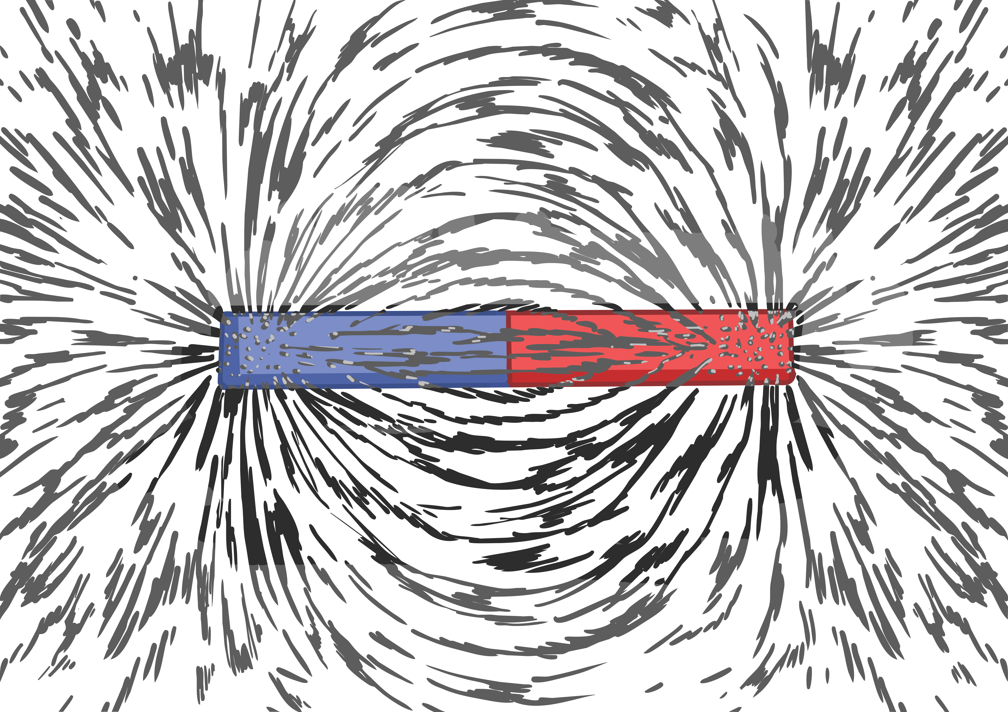
Plotting Field Lines
The other race competitors have been so impressed by your ability to make your own compass that they want to know how magnets work and how magnets are able to create magnetic field lines around them which cannot be seen.
The magnetic field lines around the magnet demonstrate how magnetic forces work and show how magnets are able to attract or repel magnetic objects.
This can be demonstrated using iron filings as the tiny fragments of iron act like a compass and line up along the magnetic field line.

Slide 13
Plotting Field Lines
You are now going to plot your own field lines.
In your groups, you will need to collect the following equipment: a bar magnet,
A3 piece of paper, pen and a plotting compass.
Step 1 – Gather your equipment.
Step 2 – Place the magnet in the centre of the page and draw around the magnet.
Label the north and south poles.
Step 3 – Place the plotting compass at the top of the south pole in the centre.
Step 4 – The needle head will point away from the magnet. Where the needle head
points, place a dot with your pen on the paper.
Step 5 – Move the plotting compass so that the needle tail is next to the dot on the
paper and repeat. Place a dot on the paper where the needle head is.
Step 6 – Continue to do this until you reach the edge of the paper.
Step 7 – Repeat steps 1-6, but start at a different place on the magnet each time.

Slide 14
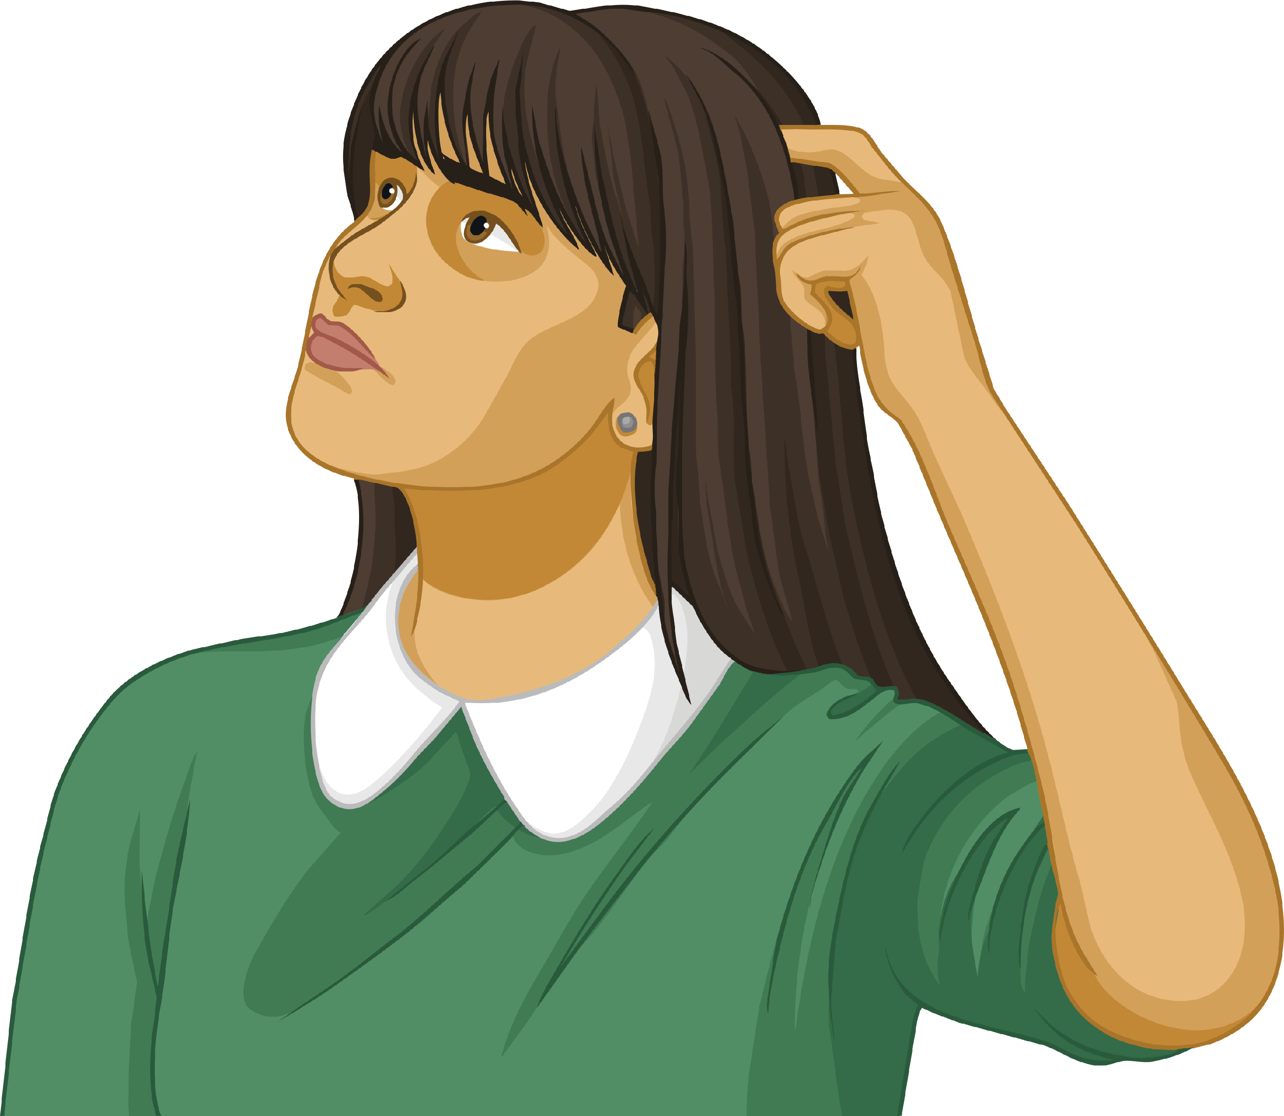
Exam Questions
Challenge yourself and apply your knowledge to these exam questions about magnets.
A pupil has two magnets; she holds the north pole of a magnet near to the north pole of a second magnet. What will happen to the magnets?
A pupil is attempting to pick up plastic paperclips with a magnet. Explain why the pupil cannot pick up the plastic paperclips.
The magnets will repel as they are the same pole.
Plastic is not magnetic and so will not be attracted towards the magnet.

Slide 15


Plenary – Spot the Magnet
For each of the three pictures, draw where you think the magnet is.
This symbol represents a compass needle.

Slide 16

Plenary – Spot the Magnet Answers
For each of the three pictures, draw where you think the magnet is.
This symbol represents a compass needle.

